Slide 1
Module 3: Optical Communication Systems LASERS – Basic Concepts
EXTC – BE – Optical Communication (ECC703)
Prof. Shyamala Mathi
Assistant Professor
Dept. of Electronics and Telecommunication,
SIES Graduate School of Technology

Slide 2
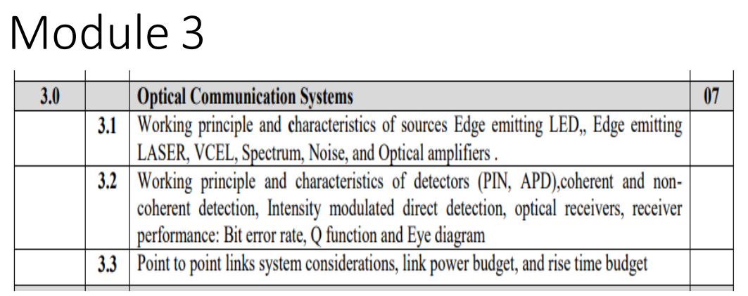

Slide 6
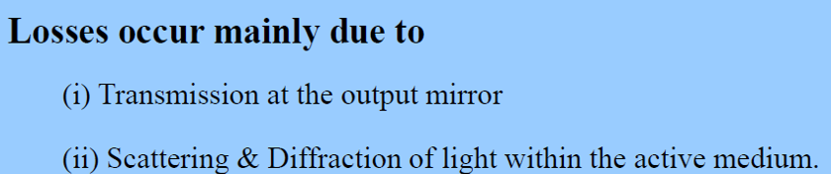
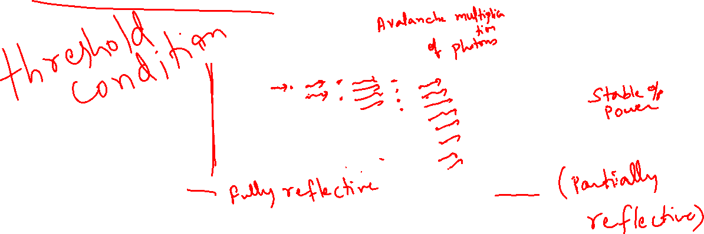

Slide 7
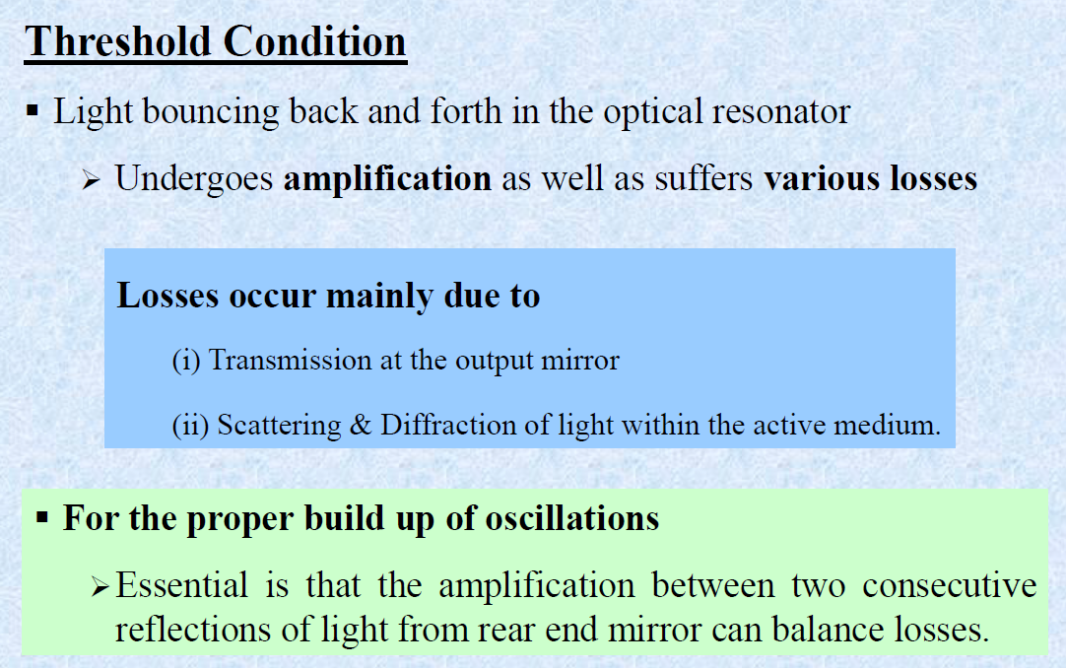

Slide 8
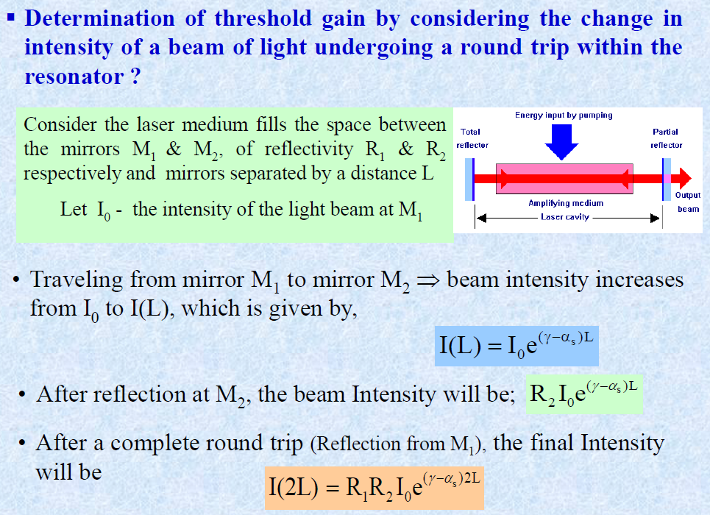
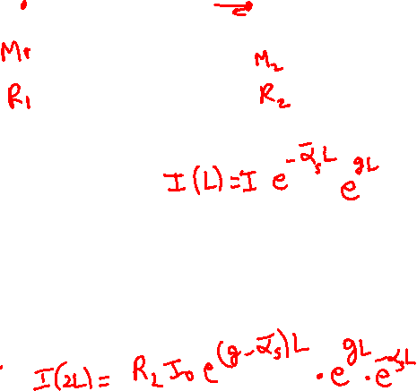

Slide 9
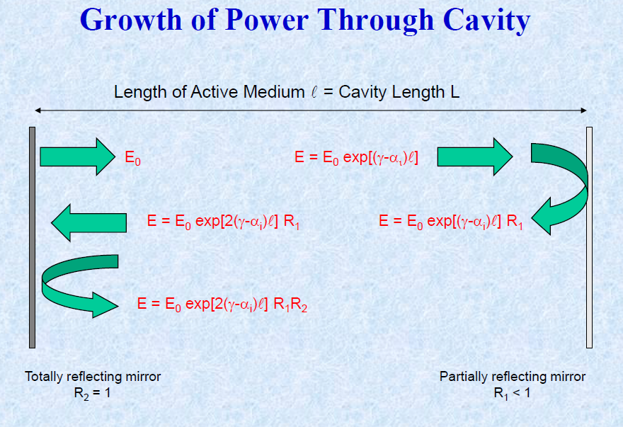

Slide 10
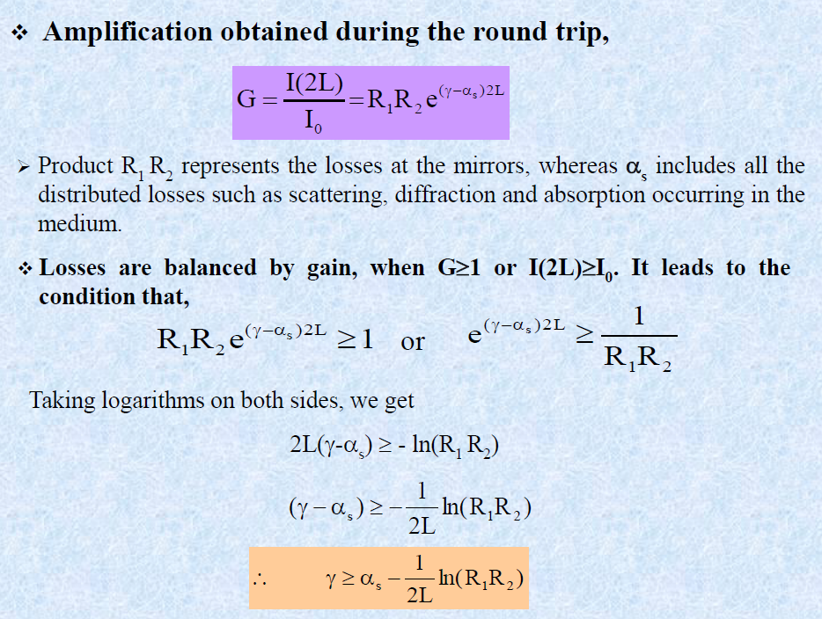

Slide 12


Slide 15
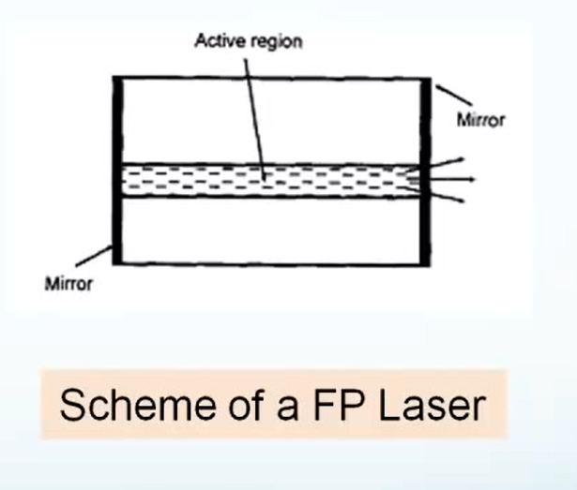

Slide 16
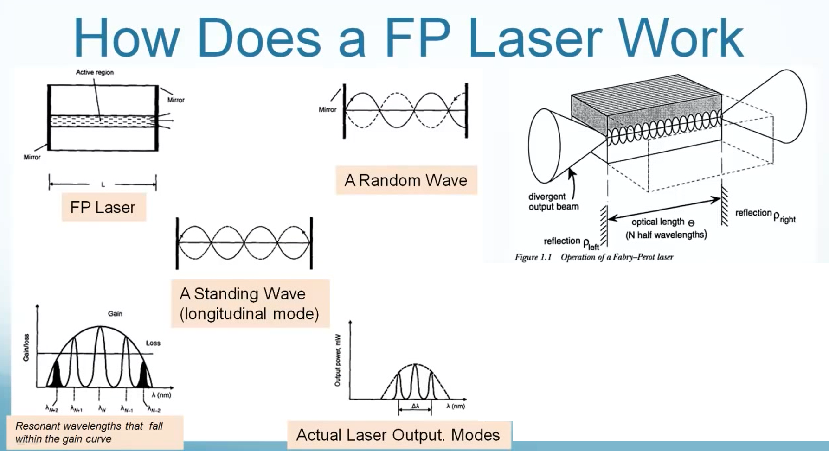
Lambda = 2nL/m

Slide 17



Slide 18
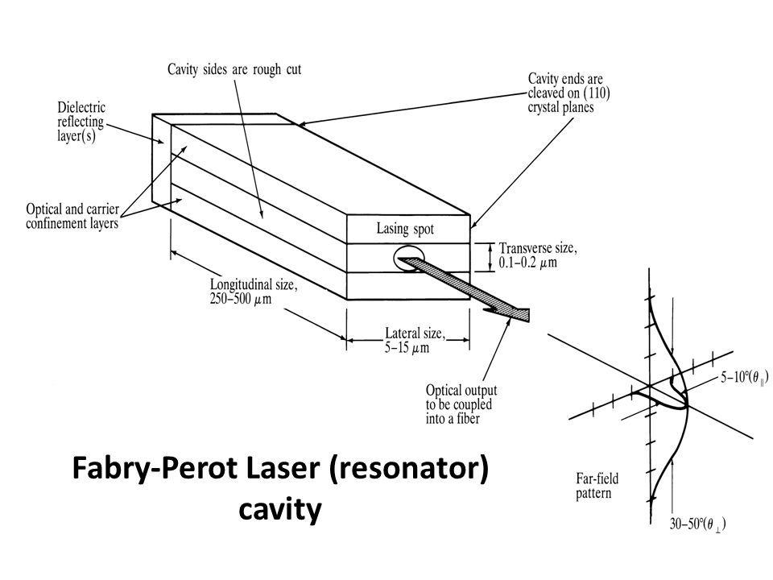

Slide 19
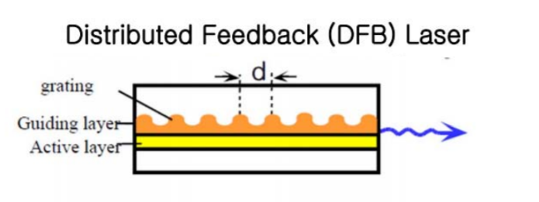
Distributed Feedback Laser

Slide 20
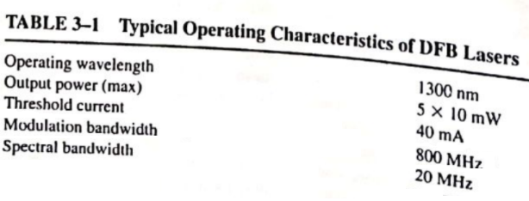

Slide 21
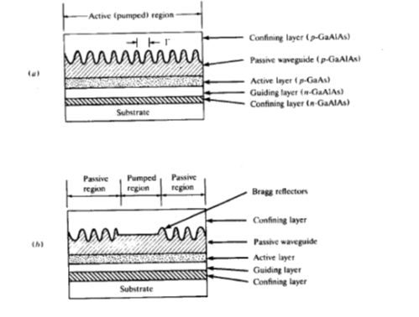

Slide 22
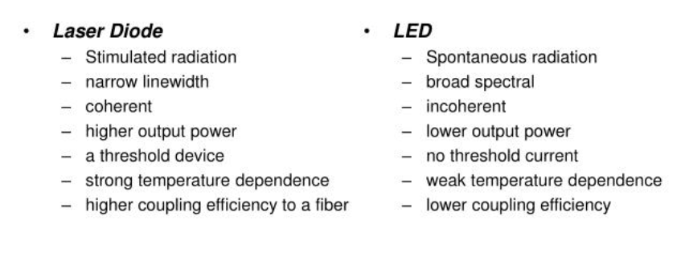
Lasers used in conventional optical communication system –
Fabry Perot Laser – Multiwavelength Laser
Distributed feedback Laser – Single wavelength Laser (single mode Laser)
Distributed Bragg Reflector – Single wavelength Laser (single mode Laser)
Lasers used in advanced optical communication system –
Single Quantum Well Lasers – Multiwavelength Laser
Multiple Quantum Well Lasers – Multiwavelength Laser
Vertical Cavity Surface emitting Lasers – Single wavelength Laser

Slide 23
Requirements of light sources:
Output should be Linear
High quantum sufficiency
Highly directional
High modulation Bandwith
Stable output power

Slide 24
In addition to the previously mentioned requirements, the following are also required:
Minimum drive current
Minimum or zero spectral width

Slide 25
Lasers with double heterojunction
Current density can be increased by having
1. high drive current and
2. reducing cross-sectional area of active region

Slide 29
Lambda = 2*neff*grating period
FBG
FBG

Slide 30
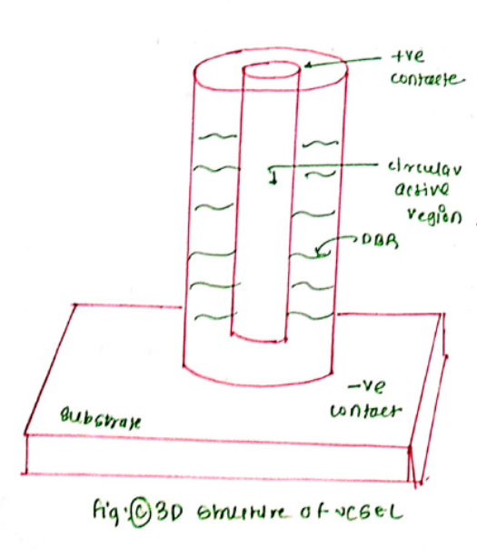

Slide 33
Thank You!
(shyamalae@sies.edu.in)

